Slide 1
PBIS
PTO Presentation

Slide 2
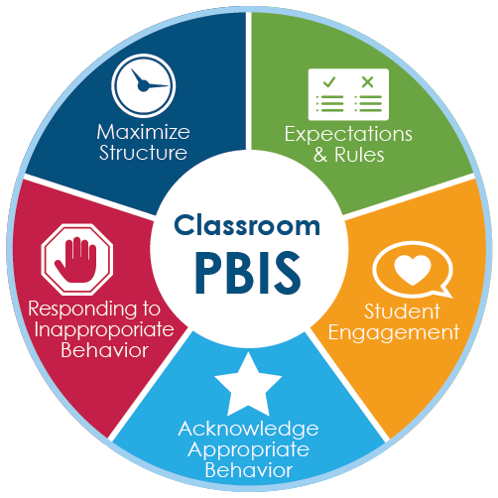
What is PBIS?
PBIS
Positive
Behavior
Intervention
And
Supports

Slide 3
PBIS Matrix
https://docs.google.com/document/d/14BoWf-qUv1yMfZuMQHHxCIcxeRGOePrSZ24hzwp0TmA/edit

Slide 4
https://www.youtube.com/watch?v=URR7A33ArTY
PBIS Video

Slide 6
The 3 R’s
Bee Ready!
Bee Respectful!
Bee Responsible!

Slide 7
PBIS Rewards

Slide 8
Who can students earn points from?
ANYONE!
All staff at HG Blake are able to award points to all students!

Slide 9
74,082
Whoa! That’s a big number! (Points awarded to students year-to-date)

Slide 10
https://docs.google.com/document/d/1Q3FaWqQhBff95R0vCPJhh2kQ7e0VBXylKECLgxsbd08/edit

Slide 11
PBIS Rewards Store
https://app.pbisrewards.com/runstore.php

Slide 12
Thanks!
Any questions?
You can contact me at lavdase@medinabees.org

